Slide 1
Chapter 8
The Memory System
Part I

Slide 2
Chapter Outline
Basic memory circuits & memory organization
Memory technology

Slide 3
Basic Concepts
Access provided by processor-memory interface
Address and data lines, and also control lines for command (Read/Write), timing, data size
Memory access time is time from initiation to completion of a word or byte transfer
Memory cycle time is minimum time delay between initiation of successive transfers
Random-access memory (RAM) means that access time is same, independent of location

Slide 4
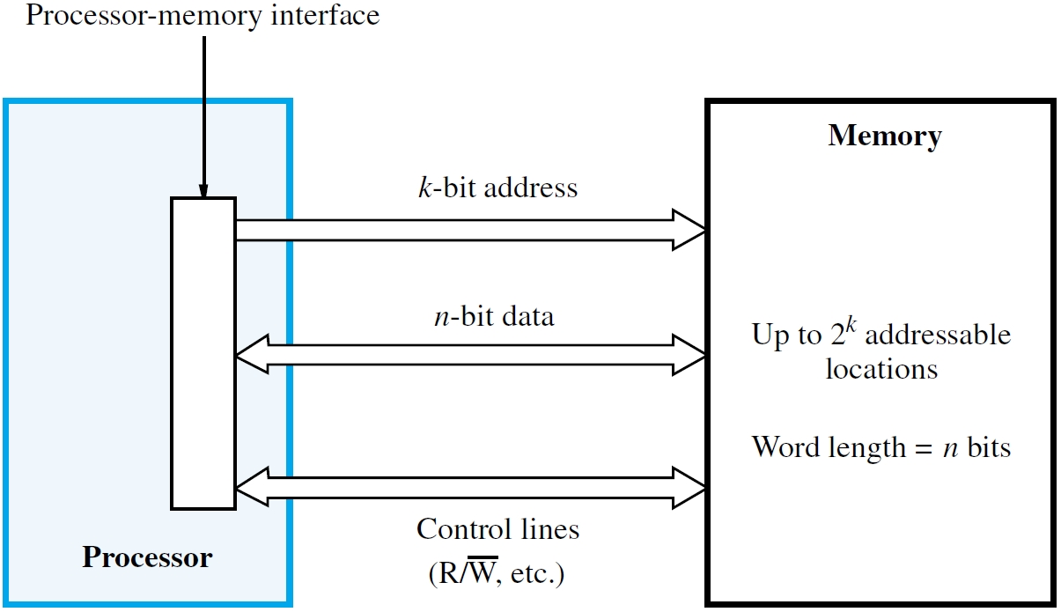

Slide 5
Semiconductor RAM Memories
Memory chips have a common organization
Cells holding single bits arranged in an array
Words are rows; cells connected to word lines (cells per row ≠ bits per processor word)
Cells in columns connect to bit lines
Sense/Write circuits are interfaces between
internal bit lines and data I/O pins of chip
Typical control pin connections include
Read/Write command and chip select (CS)

Slide 6
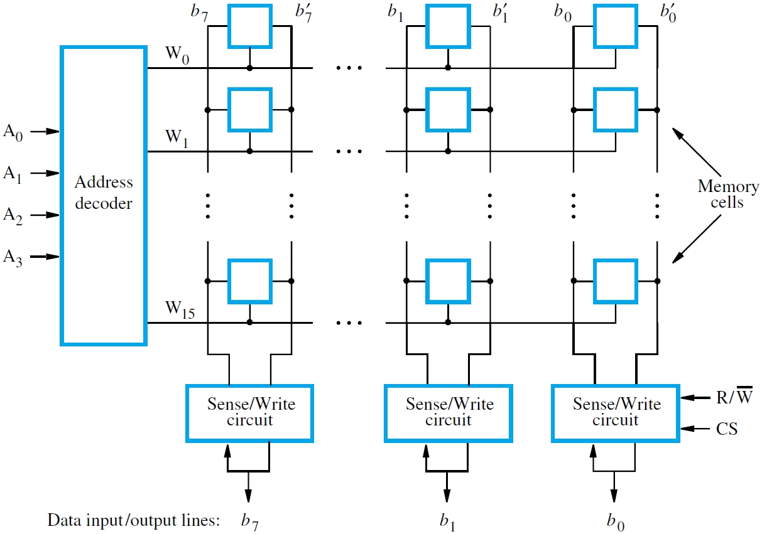

Slide 7
Internal Organization and Operation
Example of 16-word × 8-bit memory chip has
decoder to select word line from 4-bit address
Two complementary bit lines for each data bit
External source provides stable address bits, and asserts chip-select input with command
For Read operation, Sense/Write circuits transfer data from selected row to I/O pins
For Write operation, Sense/Write circuits transfer data from I/O pins to selected cells

Slide 8
More on Chip Organization
Preceding 16×8 chip has only 128 storage cells
With power/ground, need 4+8+2+2=14 pins
Larger chips: similar organization, more pins
For example, a chip with 1024 cells could be organized as 128×8 (7+8+2+2=19 pins) or alternatively as 1024×1 (10+1+2+2=15 pins)
Pin count dictates cost, so consider 1024×1
Use 32×32 array & divide address bits to have 5 upper bits for row, 5 lower bits for column

Slide 9
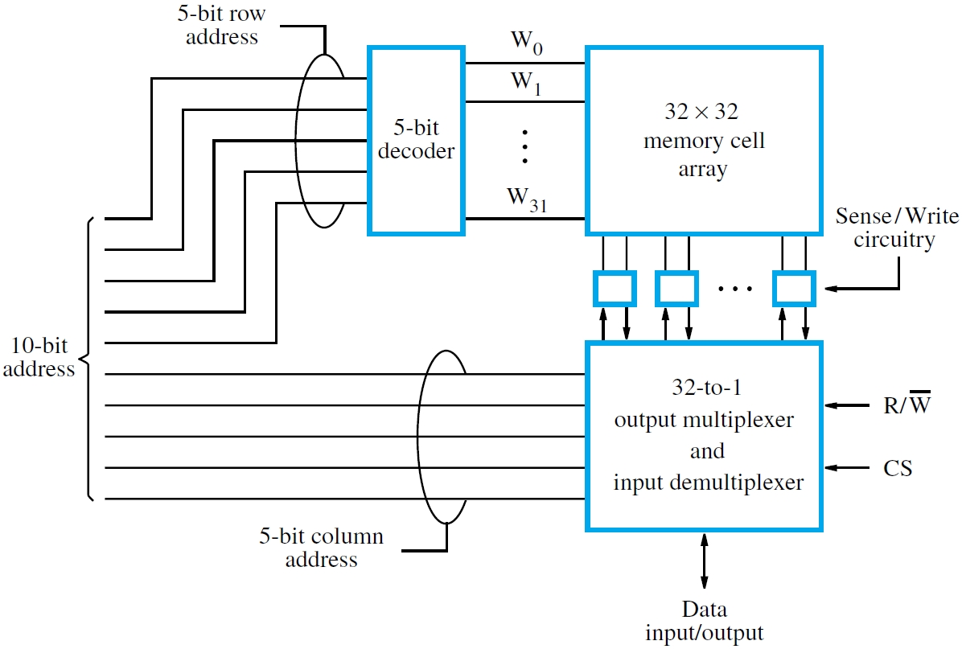

Slide 10
Static RAMs and CMOS Cell
Static memories need power to retain state;
usually has short access time (few nanosecs.)
A static RAM cell in a chip consists of
two cross-connected inverters to form a latch
Chip implementation typically uses CMOS cell
whose advantage is low power consumption
Two transistors controlled by word line act as switches between the cell and the bit lines
To write, bit lines driven with desired data

Slide 11
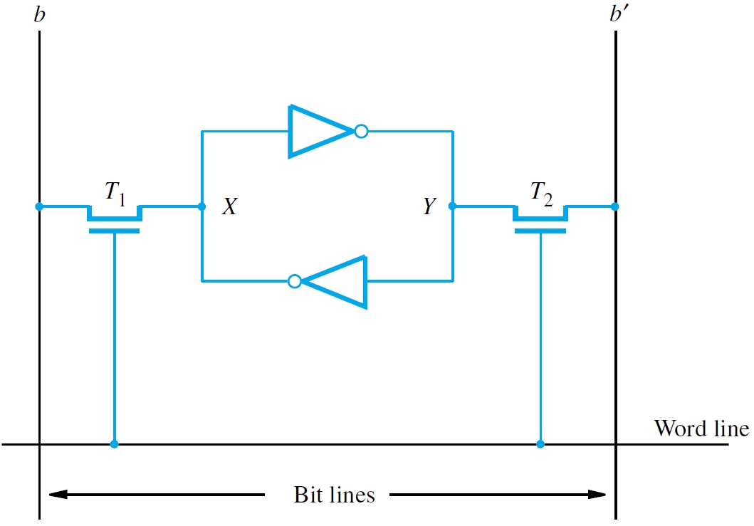

Slide 12
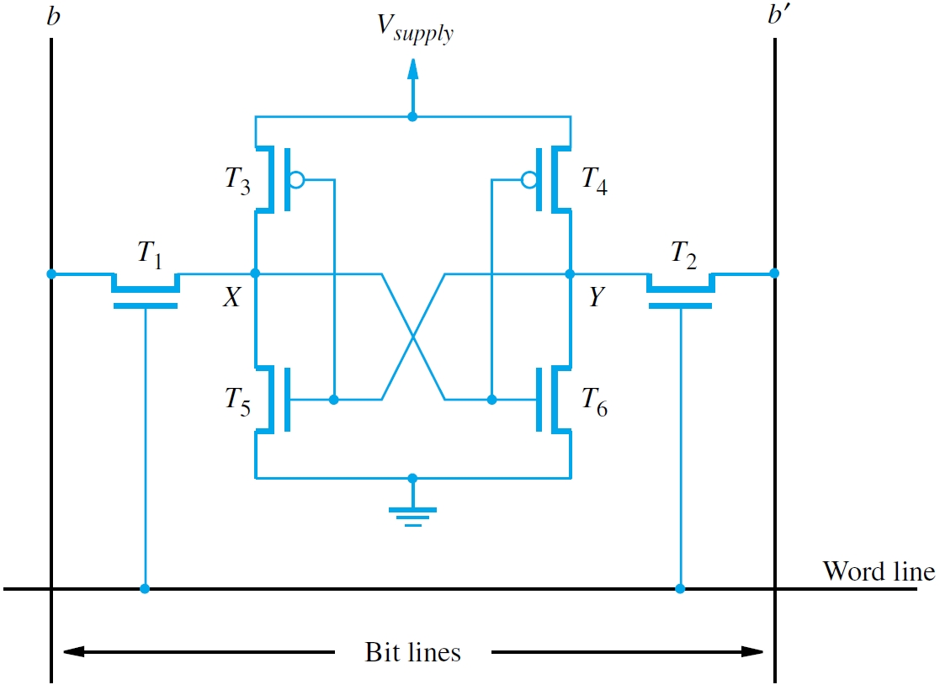

Slide 13
Dynamic RAMs
Static RAMs have short access times, but need several transistors per cell, so density is lower
Dynamic RAMs are simpler for higher density and lower cost, but access times are longer
Density/cost advantages outweigh slowness
Dynamic RAMs are widely used in computers
Cell consists of a transistor and a capacitor
State is presence/absence of capacitor charge
Charge leaks away and must be refreshed

Slide 14
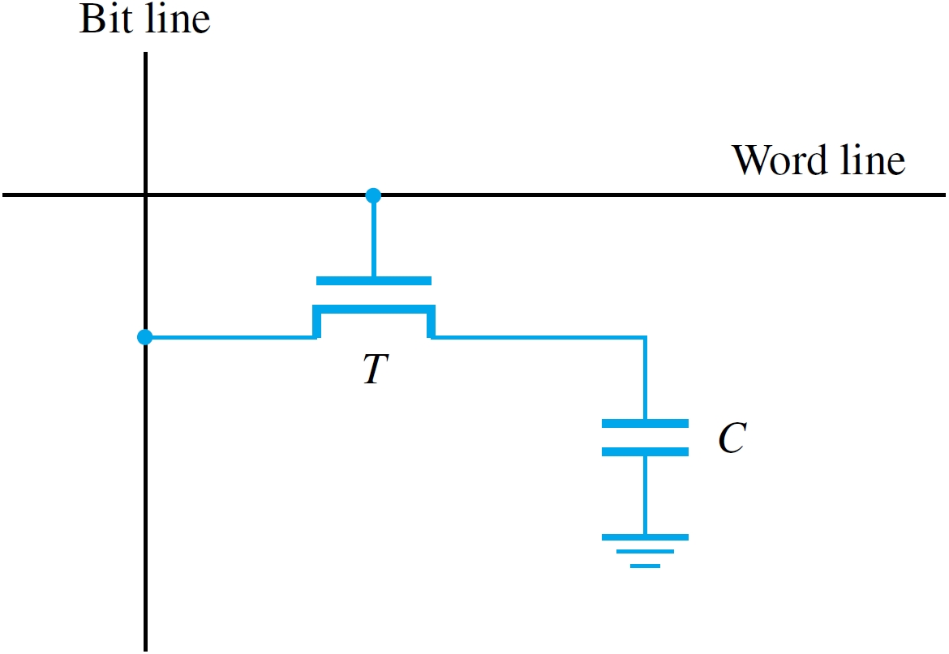

Slide 15
Dynamic RAM Chip Operation
Reflects general principles of chip operation
For Read, charge from cells in selected row
is checked by sense amplifiers on bit lines
1 or 0 if charge is above or below threshold
Action of sensing the bit lines also causes refresh of charge in all cells of selected row
For Write, access the row and drive bit lines
to alter amount of charge in subset of cells
Refresh rows periodically to maintain charge

Slide 16
More on Dynamic RAM Chips
Consider 32M × 8 chip with 16K × 16K array
16,384 cells per row organized as 2048 bytes
14 bits to select row, 11 bits for byte in row
Use multiplexing of row/column on same pins
Row/column address latches capture bits
Row/column address strobe signals for timing (asserted low with row/column address bits)
Asynchronous DRAMs: delay-based access, external controller refreshes rows periodically

Slide 17
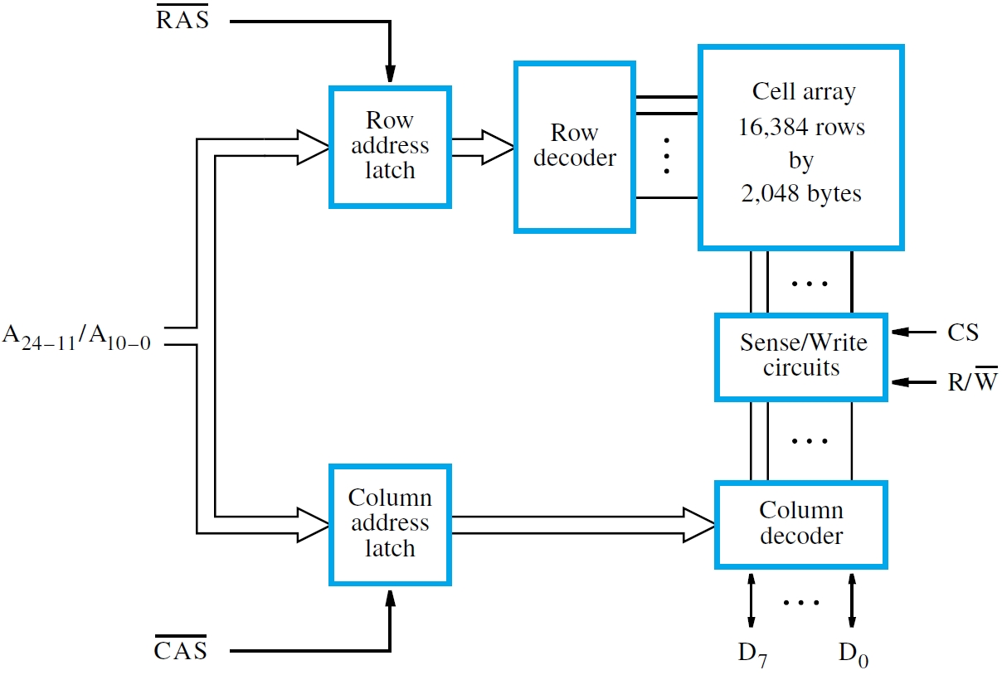

Slide 18
Fast Page Mode
In preceding example, all 16,384 cells in a row are accessed (and also refreshed as a result)
But only 8 bits of data are actually transferred
for each full row/column addressing sequence
For more efficient access to data in same row, latches in sense amplifiers hold cell contents
For consecutive data, just assert CAS signal and increment column address in same row
This fast page mode is useful in block transfers

Slide 19
Synchronous DRAMs
In early 1990s, DRAM technology enhanced
by including clock signal with other chip pins
More circuitry also added for enhancements
These chips are called synchronous DRAMs
Sense amplifiers still have latching capability
Additional benefits from internal buffering
and availability of synchronizing clock signal
Internal row counter enables built-in refresh instead of relying on external controller

Slide 20
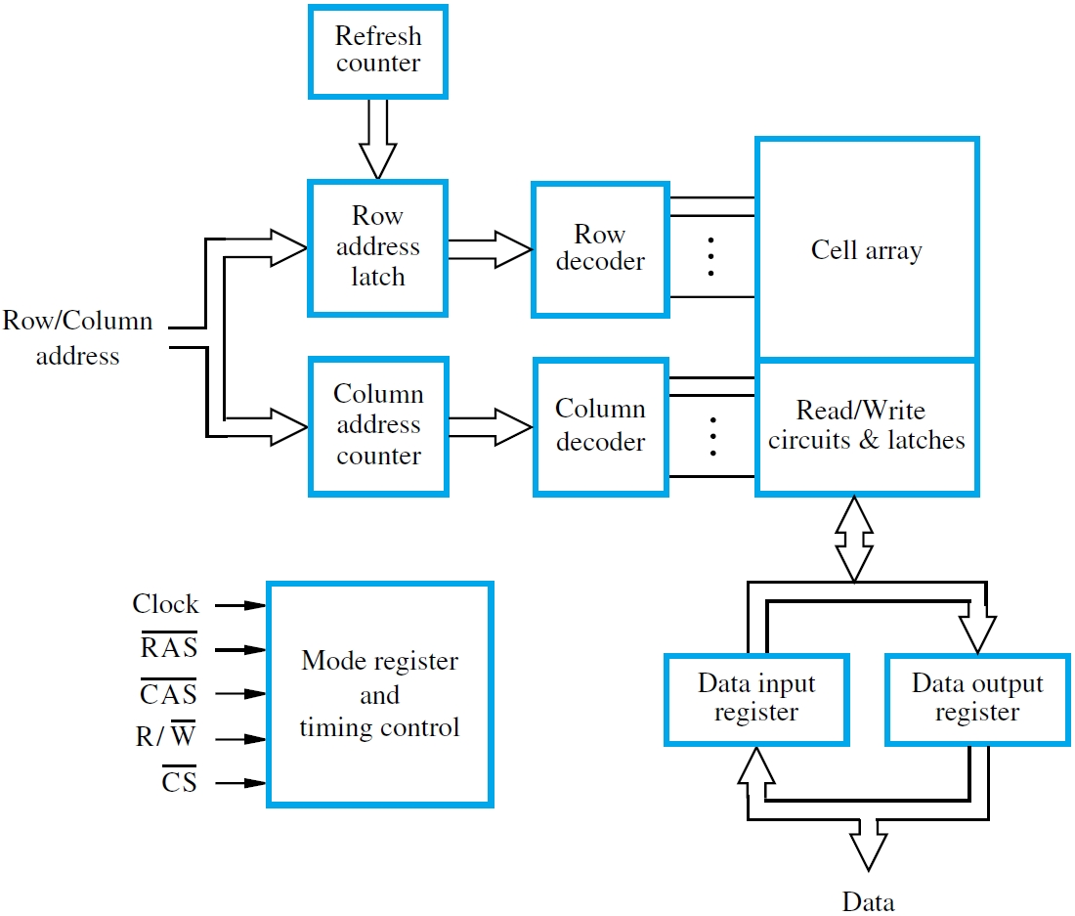

Slide 21
SDRAM Features
Synchronous DRAM (SDRAM) chips include data registers as well as address latches
New access operation can be initiated while data are transferred to or from these registers
Also have more sophisticated control circuitry
SDRAM chips require power-up configuration
Memory controller initializes mode register
Used to specify burst length for block transfers and also to set delays for control of timing

Slide 22
Efficient Block Transfers
Asynchronous DRAM incurs longer delay from CAS assertion for each column address
Synchronous DRAM reduces delay by having CAS assertion once for initial column address
SDRAM circuitry increments column counter and transfers consecutive data automatically
Burst length determines number of transfers
Consider example with burst length of 4,
RAS delay of 3 cycles, CAS delay of 2 cycles

Slide 23
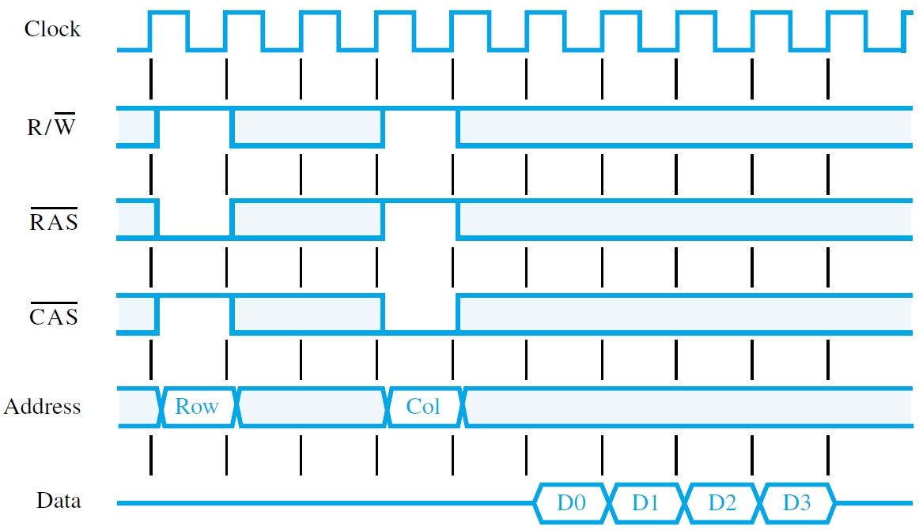

Slide 24
Double-Data-Rate (DDR) SDRAM
Early SDRAMs transferred on rising clock edge
Later enhanced to use rising and falling edges
Doubles effective rate after RAS/CAS assertion
Requires more complex clock/control circuitry
Internal array access not significantly faster
How can transfer rate be effectively doubled?
Interleave consecutive data across two arrays
Switch between arrays for each clock edge

Slide 25
Structure of Larger Memories
Internal chip organization has been discussed
Larger memories combine multiple chips
How are these chips connected together?
  Consider an example based on static memory
  Memory size is 2M words, each 32 bits in size
  Implement with 512K × 8 static memory chips
  4 chips for 32 bits, 4 groups of 4 chips for 2M

Slide 26
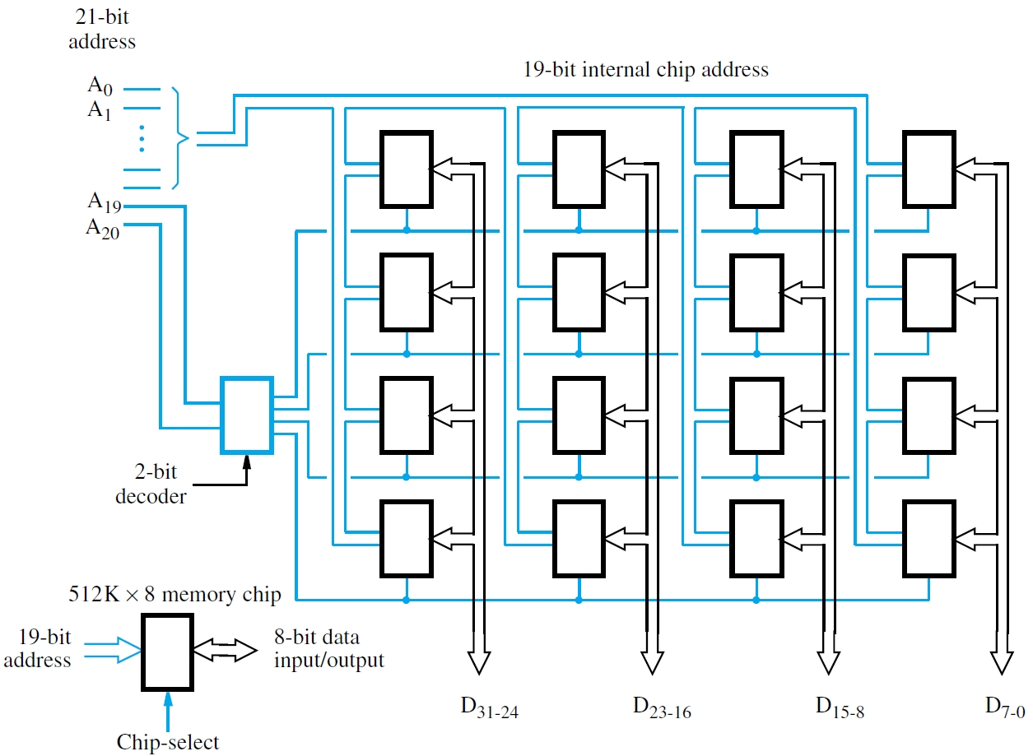

Slide 27
Address Decoder and Tri-state Pins
2M word-addressable memory needs 21 bits
Each chip has only 19 address bits (2¹⁹ = 512K)
Address bits A₂₀ and A₁₉ select one of 4 groups
Outputs of 2-bit decoder drive chip-select pins
Only the selected chips respond to request
Shared data connections need tri-state circuits
When a chip is not selected (i.e., CS input is 0), its I/O pins are electrically disconnected

Slide 28
Dynamic/Expandable Memory Systems
DRAM chip capacity has grown over time with 2G bits/chip available now, and more in future
Individual DRAM chips grouped into a module with aggregate capacity of 4 Gbytes or more
Module socket interface is standardized – SIMM and DIMM
Enables simple upgrades to increase capacity by replacing smaller modules with larger ones
Printed-circuit board can have many sockets with common lines for address and data

Slide 29
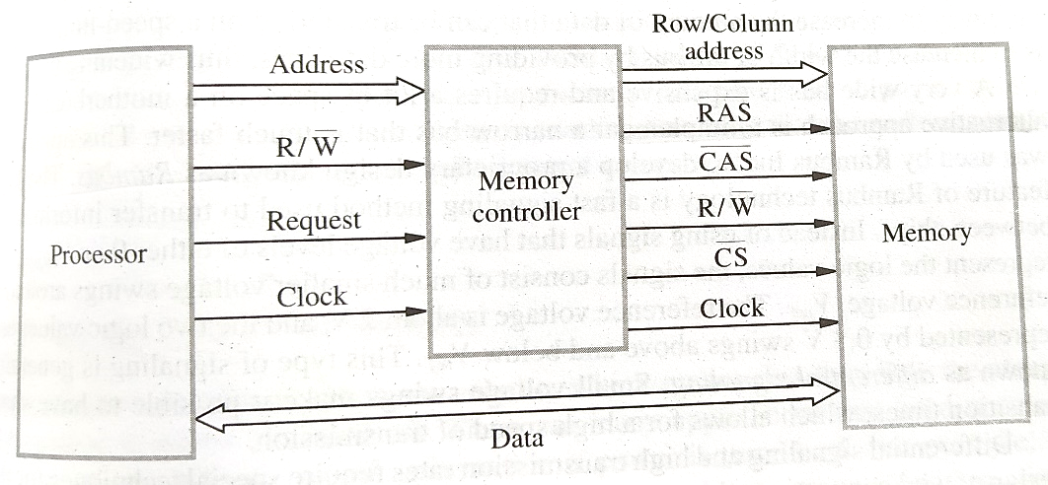
Memory Controller
Processor issues all address bits together, but DRAM chips need row/column multiplexing
A memory controller handles this task and also asserts control signals for proper timing
A large main memory is implemented using multiple DRAM modules sharing data lines
Controller decodes high-order address bits to assert chip-select signal of only one module
Other modules turn off their tri-state outputs

Slide 30
Read-only Memories
Static and dynamic RAM chips are volatile, (information retained only when power is on)
Some applications require information to be retained in memory chips when power is off
Example: computers without disk drives
Read-only memory (ROM) chips provide the nonvolatile storage for such applications
Special writing process sets memory contents
Read operation is similar to volatile memories

Slide 31
Basic ROM Cell
A read-only memory (ROM) has its contents written only once, at the time of manufacture
The basic ROM cell in such a memory contains a single transistor switch for the bit line
The other end of the bit line is connected to the power supply through a resistor
If the transistor is connected to ground,
bit line voltage is near zero, so cell stores a 0
Otherwise, bit line voltage is high for a 1

Slide 32
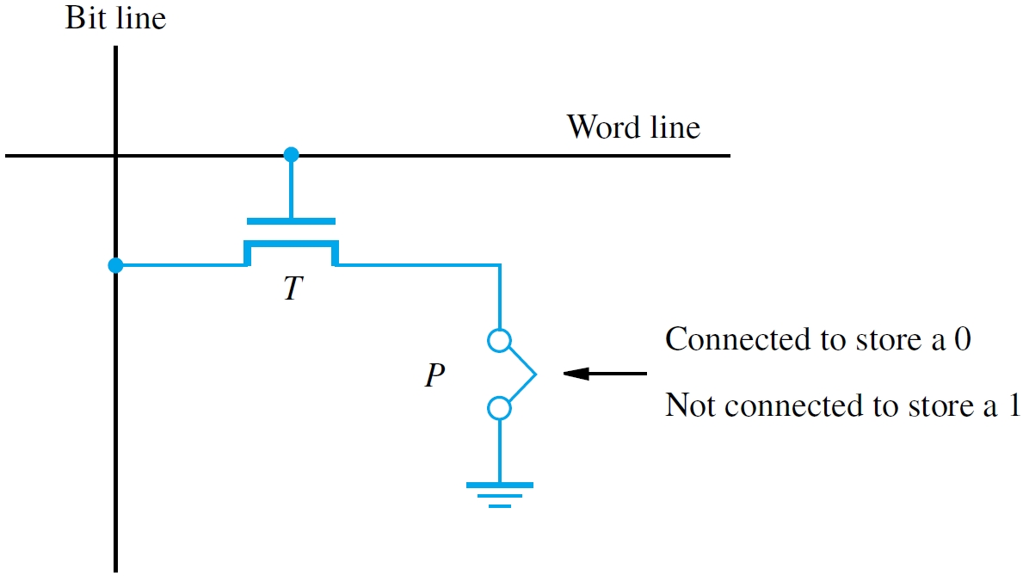

Slide 33
PROM, EPROM, and EEPROM
Cells of a programmable ROM (PROM) chip may be written after the time of manufacture
A fuse is burned out with a high current pulse
An erasable programmable ROM (EPROM) uses a special transistor instead of a fuse
Injecting charge allows transistor to turn on
Erasure requires UV light to remove all charge
An electrically erasable ROM (EEPROM) can have individual cells erased with chip in place

Slide 34
Flash Memory
Flash memory is based on EEPROM cells
For higher density, Flash cells are designed
to be erased in larger blocks, not individually
Writing individual cells requires reading block, erasing block, then writing block with changes
Greater density & lower cost of Flash memory outweighs the inconvenience of block writes
Widely used in cell phones, digital cameras, and solid-state drives (e.g., USB memory keys)

Slide 35
Sections to Read
(From Hamacher’s Book)
Chapter on Memory System
  All sections and sub-sections
    Till Section 8.3.5
    (i.e., the entire handout shared in class ending in Flash Memory)

